Slide 2
Decision Tree Classification Algorithm
Decision Tree is a Supervised learning technique that can be used for both classification and Regression problems, but mostly it is preferred for solving Classification problems. It is a tree-structured classifier, where internal nodes represent the features of a dataset, branches represent the decision rules and each leaf node represents the outcome.

Slide 3
In a Decision tree, there are two nodes, which are the Decision Node and Leaf Node. Decision nodes are used to make any decision and have multiple branches, whereas Leaf nodes are the output of those decisions and do not contain any further branches.
The decisions or the test are performed on the basis of features of the given dataset.
It is a graphical representation for getting all the possible solutions to a problem/decision based on given conditions.

Slide 4
Decision Tree Terminologies
Root Node: Root node is from where the decision tree starts. It represents the entire dataset, which further gets divided into two or more homogeneous sets.
Leaf Node: Leaf nodes are the final output node, and the tree cannot be segregated further after getting a leaf node.
Splitting: Splitting is the process of dividing the decision node/root node into sub-nodes according to the given conditions.
.

Slide 5
Branch/Sub Tree: A tree formed by splitting the tree.
Pruning: Pruning is the process of removing the unwanted branches from the tree.Parent/Child node: The root node of the tree is called the parent node, and other nodes are called the child nodes

Slide 6
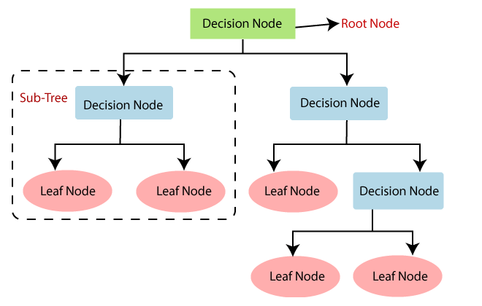

Slide 7
How does the Decision Tree algorithm Work?
Step-1: Begin the tree with the root node, says S, which contains the complete dataset.
Step-2: Find the best attribute in the dataset using Attribute Selection Measure (ASM).
Step-3: Divide the S into subsets that contains possible values for the best attributes.
Step-4: Generate the decision tree node, which contains the best attribute.
Step-5: Recursively make new decision trees using the subsets of the dataset created in step -3. Continue this process until a stage is reached where you cannot further classify the nodes and called the final node as a leaf node.

Slide 8
Attribute Selection Measures
Attribute Selection Measures
While implementing a Decision tree, the main issue arises that how to select the best attribute for the root node and for sub-nodes.
So, to solve such problems there is a technique which is called as Attribute selection measure or ASM. By this measurement, we can easily select the best attribute for the nodes of the tree. There are two popular techniques for ASM, which are:
Information Gain
Gini Index

Slide 9
Attribute Selection Measures
By this measurement, we can easily select the best attribute for the nodes of the tree. There are two popular techniques for ASM, which are:
Information Gain
Gini Index

Slide 10
Ways for constructing Decision Tree
ID3 : ID3 stands for Iterative Dichotomiser 3
CART: CART stands for classification and regression trees.
CHAID: CHAID stands for Chi-square Automatic Interaction Detector.
MARS: MARS stands for Multivariate adaptive regression splines.

Slide 11
ID3 : ID3 stands for Iterative Dichotomiser 3 .
This algorithm iteratively divides features into two or more groups at each step. Here "Iterative" means continuous/repeated and "dichotomiser" means dividing.
ID3 follows a top-down approach i.e the tree is built from the top and at every step greedy approach is applied.

Slide 12
The greedy approach means that at each iteration we select the best feature at the present moment to create a node and this node is again split after applying some statistical methods. ID3 generally is not a very ideal algorithm as it overfits when the data is continuous.

Slide 13
C4.5
C4.5: It is considered to be better than the ID3 algorithm as it can handle both discrete and continuous data. In C4.5 splitting is done based on Information gain (attribute selection measure ) and the feature with the highest Information gain is made the decision node and is further split.

Slide 14
C4.5 handles overfitting by the method of pruning i.e it removes the branches/subpart of the tree that does not hold much importance (or) is redundant. To be specific, C4.5 follows post pruning i.e removing branches after the tree is created.

Slide 15
CART
CART: CART stands for classification and regression trees. As the name suggests CART can also perform both classification and regression-based tasks. CART uses Gini’s impurity index as an attribute selection method while splitting a node into further nodes when it's a classification-based use case and uses sum squared error as an attribute selection measure when the use case is regression-based. While CART uses Gini Index as an ASM(attribute selection measure), C4.5 and ID3 use information gain as an ASM.

Slide 16
CART
CART: While CART uses Gini Index as an ASM(attribute selection measure), C4.5 and ID3 use information gain as an ASM.

Slide 17
CHAID
CHAID:
CHAID stands for Chi-square Automatic Interaction Detector. It is known to be the oldest of all three algorithms in history and is used very less these days. In CHAID chi-square is the attribute selection measure to split the nodes when it's a classification-based use case and uses F-test as an attribute selection measure when it is a regression-based use case.

Slide 18
CHAID
CHAID:
Higher the chi-square value higher is the preference given to that feature. The major difference between CHAID and CART is, CART splits one node into two nodes whereas CHAID splits one node into 2 or more nodes.

Slide 19
MARS
MARS stands for Multivariate adaptive regression splines. It is an algorithm that was specifically designed to handle regression-based tasks, provided, the data is non-linear.

